Slide 1

Prototyping & Gridding

Slide 2
Prototypes
“Users can’t tell you what they want, but when they see something and use it, they soon know what they don’t want” (Preece)
A prototype is an invaluable design tool for testing ideas, clarifying requirements and initiating user input and feedback
Core component of iterative design
Prototyping

Slide 3
What is a Prototype?
In HCI design it can be (among other things):
a series of screen sketches a storyboard, i.e. a cartoon-like series of scenes a Powerpoint slide show a video simulating the use of a system a lump of wood (e.g. PalmPilot) a cardboard mock-up a piece of software with limited functionality written in the target language or in another language
Prototyping

Slide 4
Why Prototype?
Evaluation and feedback are central to interaction design
Team members can communicate effectively
Prototypes answer questions, and support designers in choosing between alternatives
Prototyping

Slide 5
What to Prototype?
Technical issues
Work flow, task design
Screen layouts and information display
Difficult, controversial, critical areas
Prototyping

Slide 6
Types of Prototype
Fidelity refers to the level of detail:
Low Fidelity
Medium Fidelity
High Fidelity
Prototyping

Slide 7
The Design Process
Low Fidelity Prototyping/Sketching
Wireframing
Gridding
Medium/High Fidelity Prototyping
Prototyping

Slide 8
Low Fidelity Prototyping

Slide 9
Low Fidelity Prototypes
Uses a medium which is unlike the final medium, e.g. paper, cardboard
Is quick, cheap and easily changed
Examples: sketches of screens, task sequences, etc ‘Post-it’ notes storyboards ‘Wizard-of-Oz’
Prototyping

Slide 10
Storyboards
Often used with scenarios, bringing more detail
It is a series of sketches showing how a user might progress through a task using the device
Used early in design
Prototyping

Slide 11
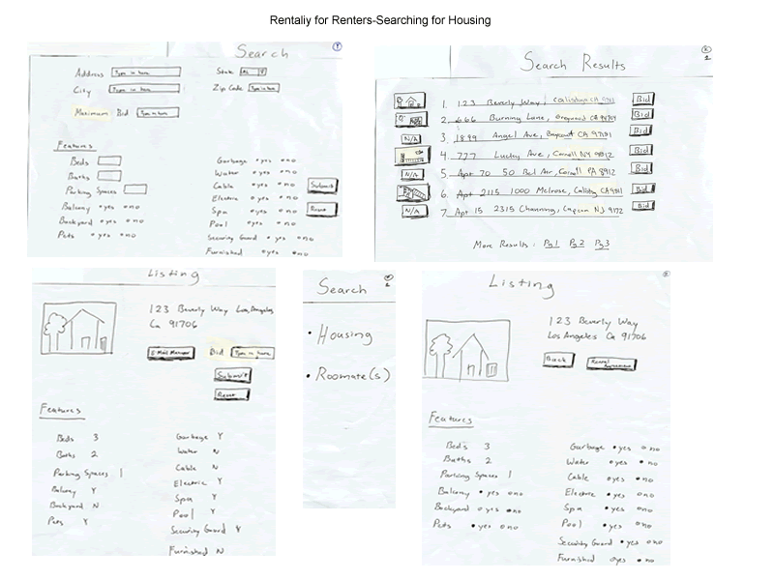
Storyboards
Prototyping

Slide 12
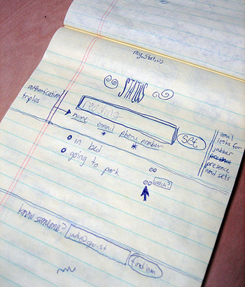
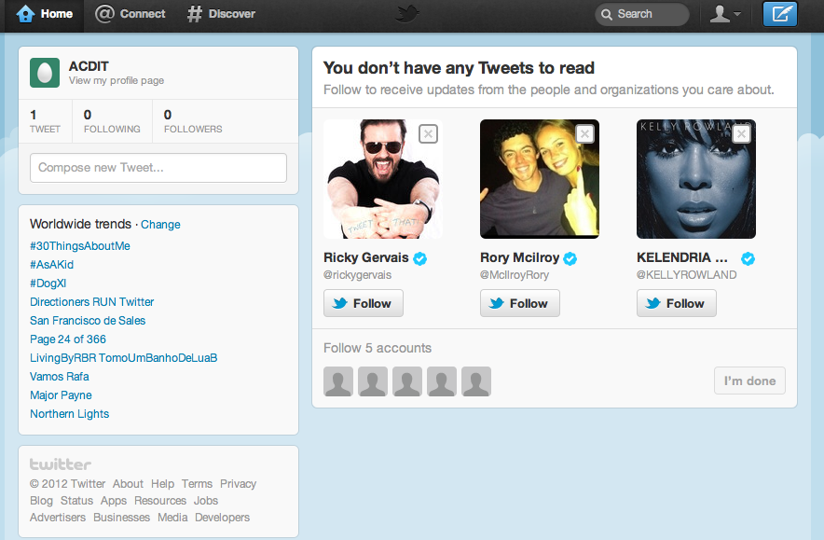
Original Twitter Prototype
Prototyping

Slide 13
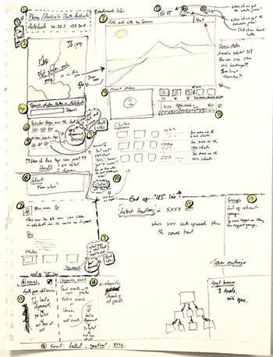
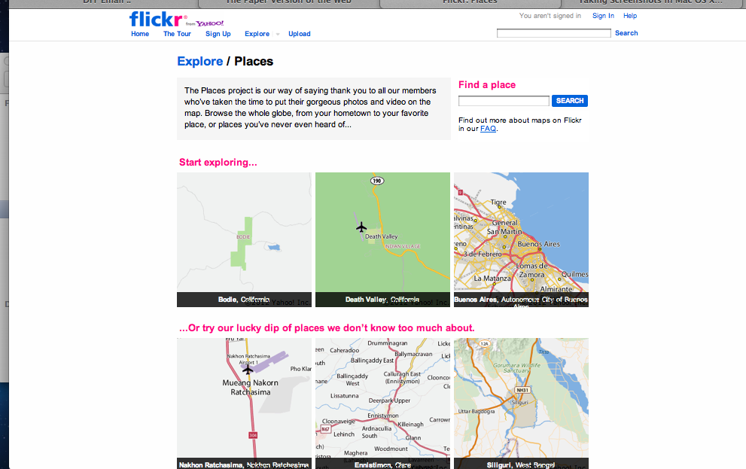
Original Flickr Places Prototype
Prototyping

Slide 14
Gridding

Slide 15
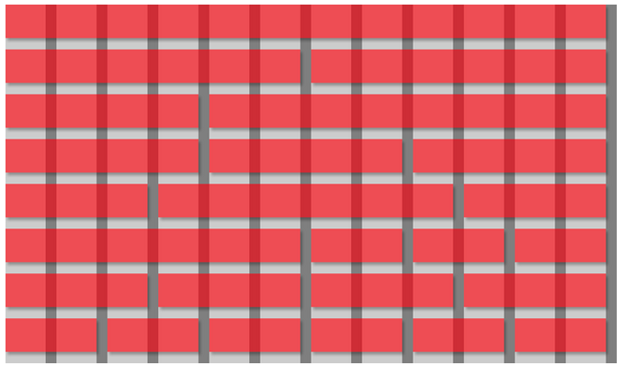
Grids for Web Design
Prototyping

Slide 16
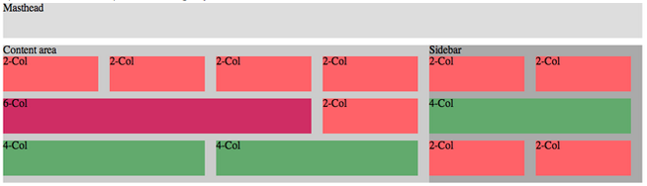
Grids for Web Design
Prototyping

Slide 17
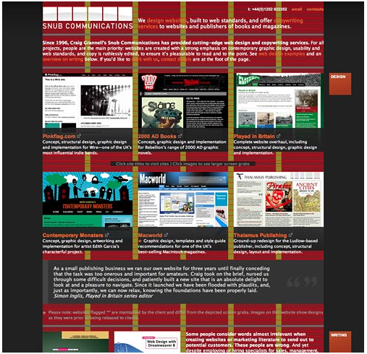
Grids for Web Design
Prototyping

Slide 18
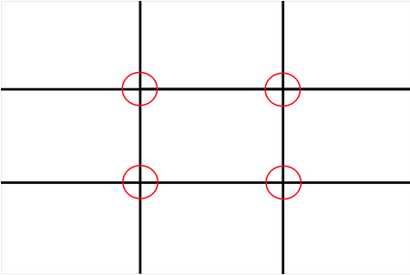
Grid Principles: Rule of Thirds
Contends that compositional strength can be found by dividing any image into 3 columns of equal width and 3 rows of equal width.
The intersection of the dividing lines forms 4 focal points to which the human eye is naturally attracted.
Prototyping

Slide 19
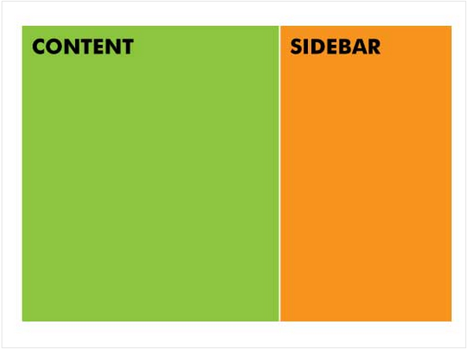
Grid Principles: Golden Ratio
Based on Fibonnacci Sequence, where Fibonnacci numbers follow a 1:1.61 ratio – Golden Ratio.
This ratio is most pleasing to the eye…
Prototyping

Slide 20

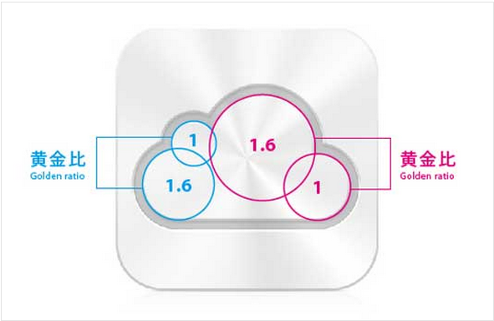
Grid Principles: Golden Ratio
Prototyping

Slide 21
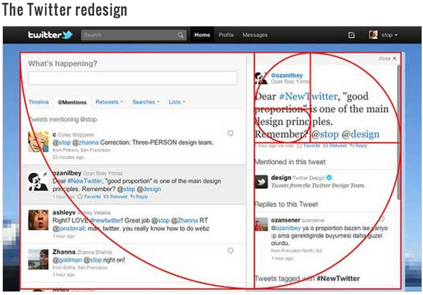
Grid Principles: Golden Ratio
Prototyping

Slide 22
Grids
What advantages are there to gridding?
What disadvantages are there to gridding?

Slide 23
Medium & High Fidelity Prototyping

Slide 24
Medium Fidelity Prototyping
Prototyping with a computer
simulate some but not all features of the interface
engaging for end users
Purpose
provides sophisticated but limited scenario for the user to try
can test more subtle design issues
Dangers
user’s reactions often “in the small”
users reluctant to challenge designer
Users reluctant to touch the design
management may think its real!
Prototyping

Slide 25
High Fidelity Prototyping
Uses materials that you would expect to be in the final product.
Prototype looks more like the final system than a low-fidelity version.
Danger that users think they have a full system…….
Prototyping

Slide 26
Horizontal vs. Vertical
Prototyping
Two common types of compromise
Horizontal prototype – shows user interface but has limited functionality behind the buttons/controls. No database links included.
Vertical prototype – contains all of the high level and low level functionality of particular areas in the system
Prototyping

Slide 27
Prototyping S/w Tools
Production tools
(that can be used
for prototyping too)
Prototyping
tools
Specifically used for prototyping
Prototyping

Slide 28
Prototyping S/w Tools
Production tools:
Produces re-usable software
Constraints of producing quality s/w not necessarily compatible with prototyping
Code management over head can slow production
Higher costs of producing prototype
Requires development skills -
Prototyping

Slide 29
Prototyping S/w Tools
Prototyping specific tools
Faster
Can be used by non technical staff
Must be throw-away
May not look exactly like future system
May limit what can be configured
Prototyping

Slide 30

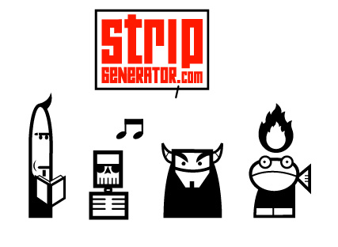

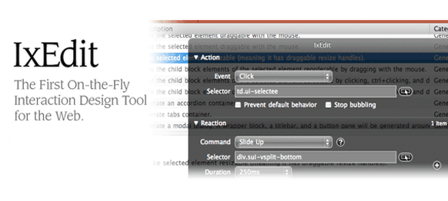
Prototyping Specific Tools
Prototyping

Slide 31
References
Terry Felke-Morris (2013), Web Development and Design Foundations with HTML
Khoi Vinh (2011), Ordering Disorder: Grid Principles for Web Design
Prototyping

